Slide 1
Example 1: Single Loop
Code:
for(i=0;i<n;i++)
printf("Hello");
Time Complexity: O(n)
Explanation: Loop runs n times.

Slide 2
Example 2: Constant Work in Loop
Code:
for(i=0;i<n;i++)
a=b+c;
Time Complexity: O(n)
Explanation: Constant work n times.

Slide 3
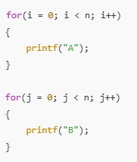
Example 3: Two Independent Loops
Two loops each run n times.
Time Complexity: O(n)
Explanation: n + n = 2n → O(n).
(constant 2 is ignored)

Slide 4
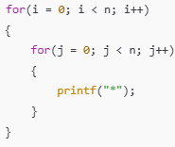
Example 4: Nested Loops
Outer loop n times
Inner loop n times
Time Complexity: O(n²).
Outer loop runs n times
Inner loop runs n times for each outer loop
Total operations = n × n

Slide 5
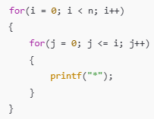
Example 5: Triangular Loop
Time Complexity: O(n²).
Inner loop runs 1, 2, 3, … n times
Total operations = n(n+1)/2

Slide 6

Example 6: Increment by 2
How does i change?
Starts at 1
Then: 3, 5, 7, 9, ...
Increases by 2 each time
Number of iterations
The loop runs until i <= n
So roughly:
n/2 iterations​ iterations
Time Complexity
Constants are ignored in Big-O
n/2 becomes O(n)
Loop runs n/2 times
Time Complexity: O(n).
Loop runs n/2 times
Constants are ignored

Slide 7

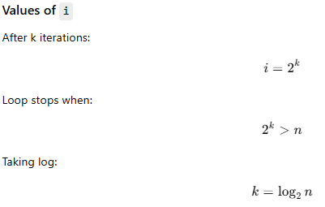
Example 7: Logarithmic Loop
i doubles each time
i doubles every iteration
Number of iterations = log₂ n
How does i change?
Starts at 1
Then: 2, 4, 8, 16, 32, ...
Multiplies by 2 each time
Time Complexity
Number of iterations = log₂ n
Time Complexity = O(log n)

Slide 8
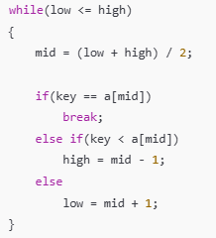
Example 8: Binary Search
Search space halves each time
Time Complexity: O(log n).
Array size reduces to half each step
Fast searching method

Slide 9
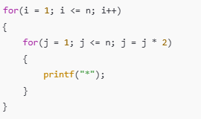
Example 9: n log n
Outer loop n
Inner loop log n
Time Complexity: O(n log n).

Slide 10

Example 10: Constant Time
Single statement
Time Complexity: O(1).
Executes only once
No dependency on input size

Slide 11
O(n!)
Example: Arranging Students in a Line
Problem
Suppose there are n students and you want to find all possible seating arrangements in a straight line.
Think of 3 students: A, B, C
Possible arrangements:
ABC
ACB
BAC
BCA
CAB
CBA
Total = 3! = 6 arrangements

Slide 12
C programs to check a prime number using a User-Defined Function (UDF). Each method uses a different logic
Method 1: Normal Approach (Check till n−1)
int isPrime(int n) {
int i;
if (n <= 1)
return 0;
for (i = 2; i < n; i++) {
if (n % i == 0)
return 0;
}
return 1;
}
How Many Times Does the Loop Run?
In the worst case, when n is prime → loop runs from 2 to n−1 → total iterations ≈ n − 2
Time Complexity
Worst Case: O(n)
Best Case: O(1) (if n is divisible by 2, loop stops immediately)
Average Case: O(n)
For number 13 :
for (i = 2; i < 13; i++)
Values of i
2, 3, 4, 5, 6, 7, 8, 9, 10, 11, 12
Number of iterations
11 times

Slide 13
Method 2: Optimized Approach (Check till n/2)
How Many Times Does the Loop Run?
In the worst case, when n is prime → loop runs approximately n/2 times
Time Complexity Calculation
n/2 → ignore constant 1/2
int isPrime(int n) {
int i;
if (n <= 1)
return 0;
for (i = 2; i <= n / 2; i++) {
if (n % i == 0)
return 0;
}
return 1;
}
Time Complexity
Worst Case: O(n)
Best Case: O(1)
Average Case: O(n)
Explanation (Exam Line)
Although the loop runs up to n/2, constants are ignored in
time complexity, so it is still O(n).
for (i = 2; i <= 13/2; i++)
13/2 = 6
Values of i
2, 3, 4, 5, 6
Number of iterations
5 times

Slide 14
Method 3: Best Optimized Approach (Check till √n)
int isPrime(int n) {
int i;
if (n <= 1)
return 0;
for (i = 2; i * i <= n; i++) {
if (n % i == 0)
return 0;
}
return 1;
}
Time Complexity
Worst Case: O(√n)
Best Case: O(1)
Average Case: O(√n)
for (i = 2; i * i <= 13; i++)
√13 ≈ 3.6
Values of i
2, 3
2 × 2 = 4 ≤ 13 ✔
3 × 3 = 9 ≤ 13 ✔
4 × 4 = 16 > 13 ❌ → stop
Number of iterations
2 times
The program runs only √n times
Growth is much slower
If:
n = 100 → 10 steps
n = 10,000 → 100 steps
For number 13, the √n method checks divisibility only 2 times, making it the most efficient.

Slide 15
Finding a factor of a number:
O(n): Check every number from 1 to n
O(√n): Stop checking at √n because factors repeat after that
✔ Same result ✔ Less work ✔ Faster

Slide 16
“Time complexity tells us how fast the number of operations grows as input size n increases.”
What is input size (n)?
n represents how much data the program is working on
Examples:
Number of elements in an array
Value of a number
Number of nodes in a tree
Example: If an array has 10 elements → n = 10 If it has 1,000 elements → n = 1000
What are operations?
Operations are the basic steps a program performs, such as:
Comparisons
Loop iterations
Arithmetic calculations
Example:
for(i = 1; i <= n; i++)
{
printf("Hello");
}
Here, printf is executed n times → n operations

Slide 17
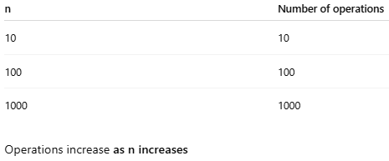
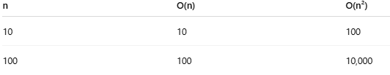
What does grows mean?
It means:
How the number of steps increases
When n becomes larger
Example:
Suppose you are checking notebooks:
O(n): Check notebooks one by one
O(n²): Check every notebook with every other notebook
As notebooks increase, the second method becomes very slow
What does how fast mean?
It compares rate of increase, not exact time.
Compare two programs:
Program A (O(n))
Operations increase linearly
Program B (O(n²))
Operations increase very fast
Program A is faster because its operations grow slowly

Slide 18
Time complexity describes how the number of operations performed by an algorithm increases as the input size n increases.
Time complexity is about growth, not exact time ✔ It helps compare algorithms ✔ Slower growth = better algorithm

